Slide 1




InstaGrader©
Welcome to our revolutionary instant C++ grader. To get started, create a new file or open an existing file. For more information on how to use this program please click on the “Help” button.
A+
?

Slide 2
InstaGrader©
Options:
A+
?

Slide 3
Click here to create a new test-scenario
InstaGrader©
To save your results, click here
Welcome to our revolutionary instant C++ grader. To get started, create a new file or open an existing file. For more information on how to use this program please click on the “Help” button.
Welcome to our revolutionary instant C++ grader. To get started, create a new file or open an existing file. For more information on how to use this program please click on the “Help” button.
A+
To view student’s grades click here.
?
To adjust the default options click here.

Slide 4
InstaGrader©
Please enter or select a folder:
A+
Browse
?

Slide 5
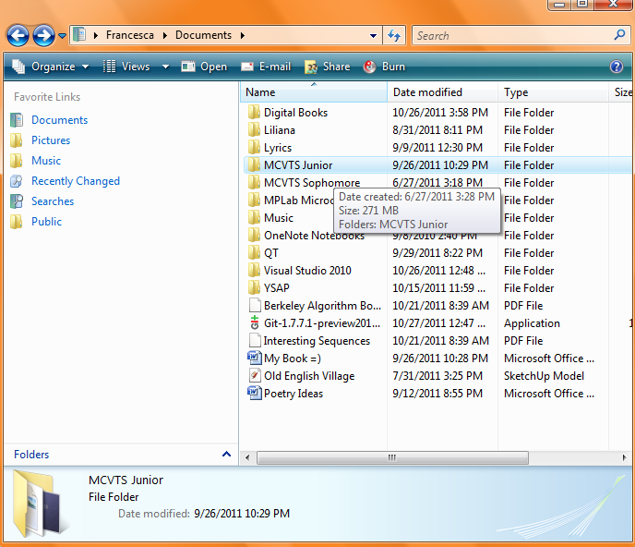
InstaGrader©
Please enter or select a folder:
A+
Browse
?

Slide 6
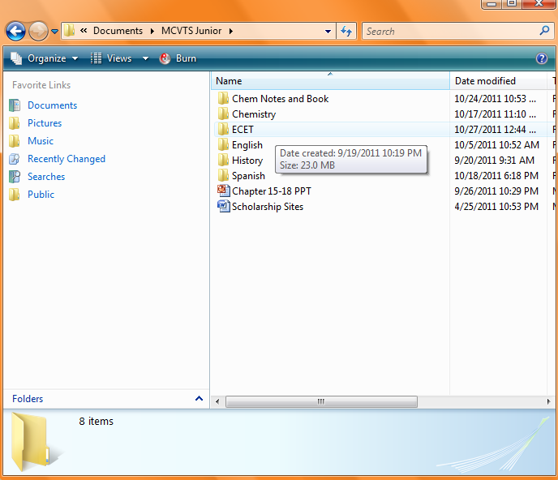
InstaGrader©
Please enter or select a folder:
A+
Browse
?

Slide 7
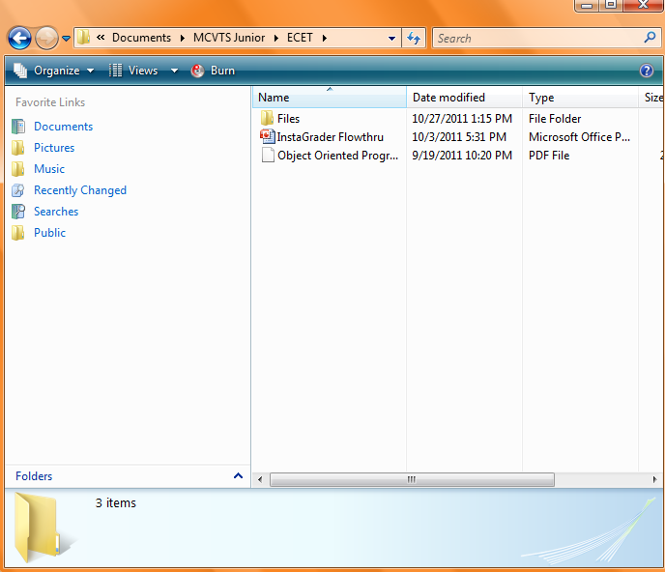
InstaGrader©
Please enter or select a folder:
A+
Browse
?

Slide 8
InstaGrader©
Please select a folder containing the cpp files you would like to grade:
A+
C:\Users\Francesca\Documen
Browse
Then, select a text file containing the answers:
Browse
?

Slide 9
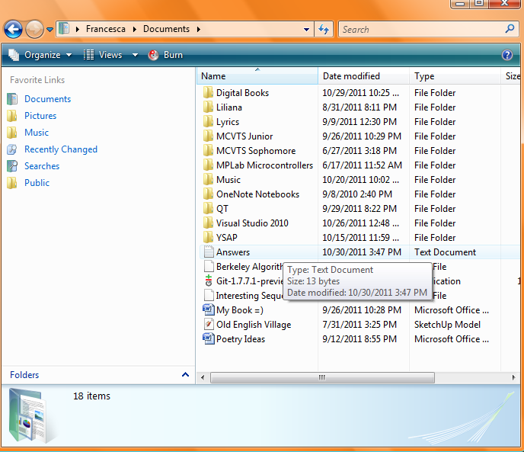
InstaGrader©
Please select a folder containing the cpp files you would like to grade:
A+
C:\Users\Francesca\Documen
Browse
Then, select a text file containing the answers:
Browse
?

Slide 10
InstaGrader©
Please select a folder containing the cpp files you would like to grade:
A+
C:\Users\Francesca\Documen
Browse
Then, select a text file containing the answers:
C:\Users\Francesca\Documen
Browse
?
Grade

Slide 11
InstaGrader©
RESULTS:
A+
Jake.cpp Fail
Blake_numbers.cpp Hang
Casey.cpp Pass
Numberplay.cpp Pass
?
Save As

Slide 12
InstaGrader©
Select the grade level you would like to save the results under:
A+
Grade 9
Grade 10
?
Grade 11
Grade 12

Slide 13
InstaGrader©
The results have been saved.
If you would like to view the current status of your students click on the “Grades” tab.
To grade more quizzes click on “New File”.
A+
?

Slide 14
InstaGrader©
Which grade level would you like view:
A+
Grade 9
Grade 10
?
Grade 11
Grade 12

Slide 15
InstaGrader©
Grade 9: Freshmen
A+
Name | Status | Grade (Average)
Name | Pass | 85
Name2 | Fail | 40
Name3 | Pass | 70
Name4 | Pass | 95
Etc
?

Slide 16
InstaGrader©
Grade 10: Sophomores
A+
Name | Status | Grade (Average)
Name | Pass | 85
Name2 | Fail | 40
Name3 | Pass | 70
Name4 | Pass | 95
Etc
?

Slide 17
InstaGrader©
Grade 11: Juniors
A+
Name | Status | Grade (Average)
Name | Pass | 85
Name2 | Fail | 40
Name3 | Pass | 70
Name4 | Pass | 95
Etc
?

Slide 18
InstaGrader©
Grade12: Seniors
A+
Name | Status | Grade (Average)
Name | Pass | 85
Name2 | Fail | 40
Name3 | Pass | 70
Name4 | Pass | 95
Etc
?

